Slide 1
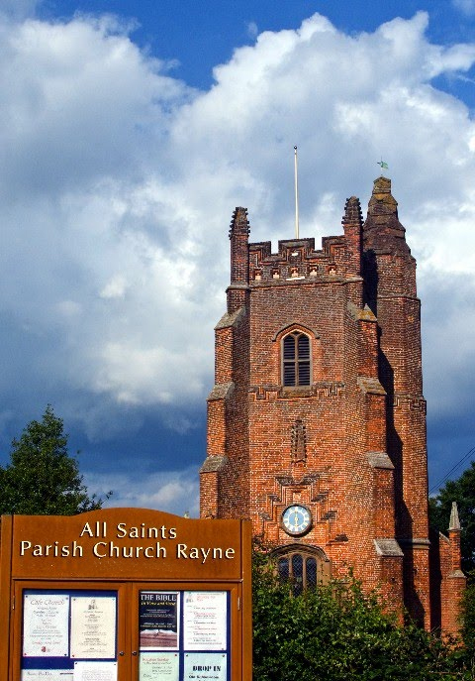
What’s Ahead
6th October 2024

Slide 2
Lunch Club
On second Thursday of the month, home cooked two course lunch, juice to start and tea/coffee £6. Speak to Kate or to Linda to book a place.
October 10th | Fish pie and seasonal vegetables | Trifle

Slide 3
Lunch Club
Is also on every Thursday in the Old Schoolroom at 12 noon.
~Friendly chat, lovely food and (usually) a light- hearted quiz. Very easy-going.
£4 per person on week 1, 3, 4 or 5

Slide 4
Rayne church stays open for visitors every day: 8 am. – 4 pm.

Slide 5
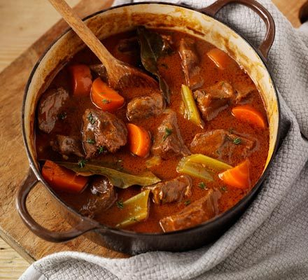
Everyone is invited to share the Harvest Supper:
In the Schoolroom in Rayne on Saturday 19th October at 6pm.
Contact: revromankuk@gmail.com
£10. Children free.

Slide 6
A Time To Be Still
Bible reading, meditation and music.
Every 4th Sunday. In Rayne church at 4 p.m.

Slide 7
KNEAD, Our church breadmaking group next meets on:
October 12th
In Rayne Church 10am to 12 noon
See Kate to reserve a place to make a harvest loaf or rolls and a wheatsheaf. £4

Slide 8
Held at the Church in Great Notley every Monday at 2 p.m.

Slide 9
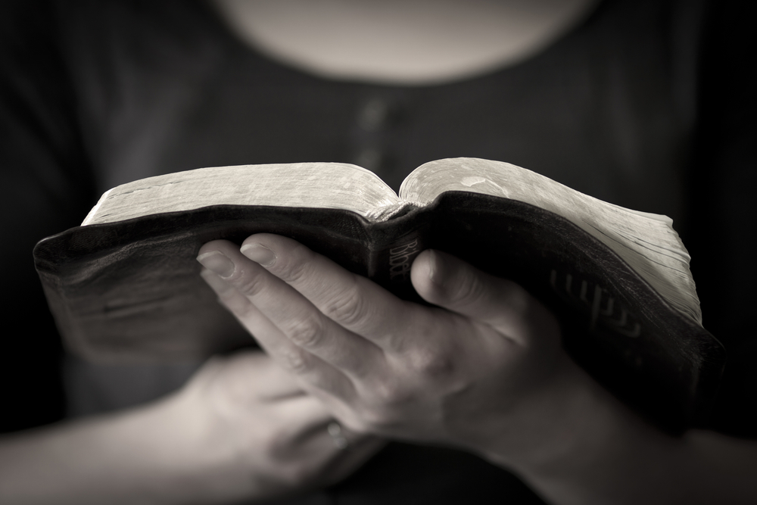
LECTIO DIVINA
In the Rectory led by Rev’d Nikki.
1st Weds. of the month. 7-8 p.m.
A deeper exploration of a Bible passage.

Slide 10
Could you help, please?
e.g.
Coffee/tea makers after services
Side-persons to greet worshippers
Cleaning the church
Joining our PCC
Reading the Bible in services
Please speak to our church wardens, Colin & Graham

Slide 11
EXPLORERS
Bringing the Bible to life for young people.
In the Florence Slater Room in Black Notley. Led by Rev’d Nikki. 4-5 p.m.
Every third Sunday of the month.

Slide 12
We have a hearing aid loop in this church.

Slide 13
Sunday Services: all at 9.30 am
1st Sunday: Morning Prayer
2nd Sunday: All-Age Worship
3rd Sunday: Modern Communion
4th Sunday: Traditional Communion
5th Sunday: Communion in one of our 3 benefice churches
Everybody is welcome

