Slide 1
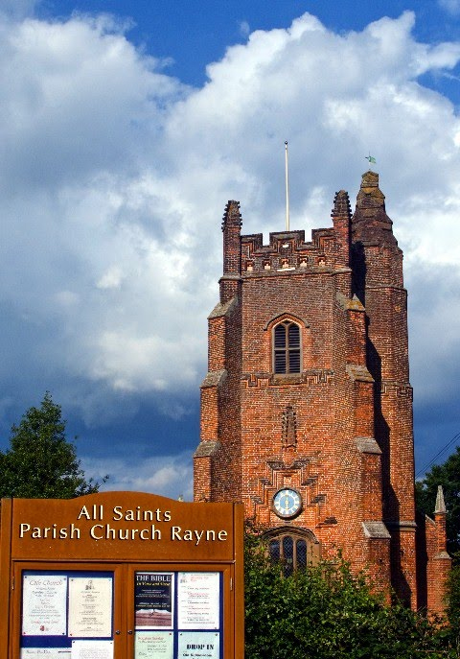
What’s Ahead for Rayne Church
9th March 2025

Slide 2
At the Church in Great Notley every Monday at 2 p.m.
Very friendly. Very Good.

Slide 3
Weekly Lunch Club
Is also on every Thursday in the Old Schoolroom at 12 noon.
~Friendly chat, choice of 2 homemade soups and 4 sandwiches made to order + usually a cake and light- hearted quiz. Very easy going. No need to book.
£4 per head

Slide 4
Bible reading, meditation and music.
Every 4th Sunday 4 p.m.
.
A ‘Time to Be’ Service of Worship in this church

Slide 5
Knead breadmaking
Maundy Thursday 17th April
10 am. to 12 noon
See Kate to book a place
We are making a Hot Cross Loaf

Slide 6
Fundraising Dates for your Diary
St Patrick’s Day Dinner Sunday 16th March 5pm
The Italian Job (An Italian meal and murder mystery set in an Italian restaurant) Saturday 12th April
Afternoon Tea and Art Exhibition in Rayne church Saturday 31st May
Mamma Mia party (Greek meal and Abba music) Saturday 5th July
Puddings and Prosecco Saturday 2nd August

Slide 7
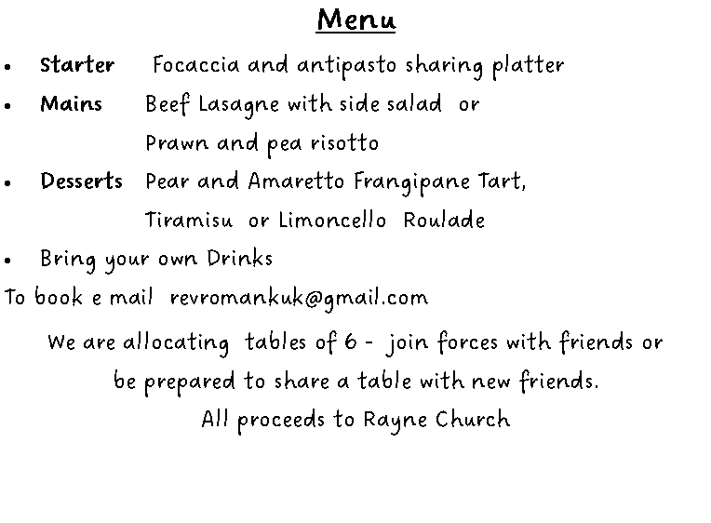
A MURDER MYSTERY AMID ITALIAN DINING
ON SATURDAY 12TH APRIL
6.30 PM AT THE OLD SCHOOLROOM, RAYNE
£15 for a three course Italian meal and a murder mystery to solve with your friends

Slide 8
Rayne church stays open for visitors every day: 8 am. – 4 pm.

Slide 9
We have a hearing aid loop in this church.

Slide 10
If you like to support Rayne church financially…
- There is a card machine at the back of church & a plate for cash offerings.

Slide 11
Editor needed for Rayne in Focus, our parish magazine
Could it be you?
Please ask Colin, Graham, Rev’d Rachel, Nikki or Roman for more information

Slide 12
Sunday Services: all at 9.30 am
1st Sunday: Traditional Communion
2nd Sunday: All-Age Worship
3rd Sunday: Modern Communion
4th Sunday: Morning Prayer
5th Sunday: Communion in one of our 3 benefice churches
(From March)
Everybody is welcome

Slide 13
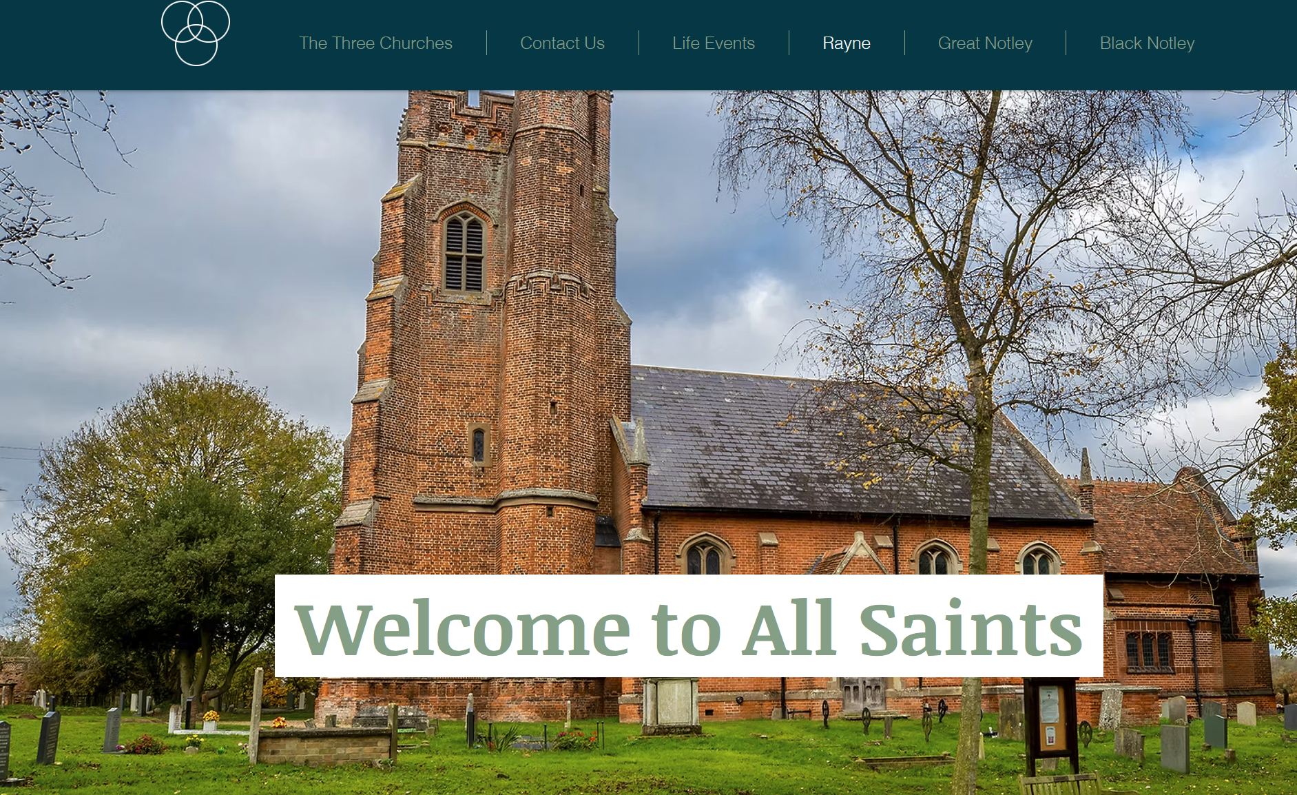
You can read all of these weekly notices on the Rayne Church section of our website:
www.thethreechurches.co.uk

